Slide 1
PHOTOGRAPHY
Mahasri
Namakkani

Slide 2
PIXEL STUDIO
Used HTML for the website format or layout.
Used CSS and bootstrap for the style.
Used JavaScript for the validation.
For the landing page, bootstrap is used to style the page.

Slide 3
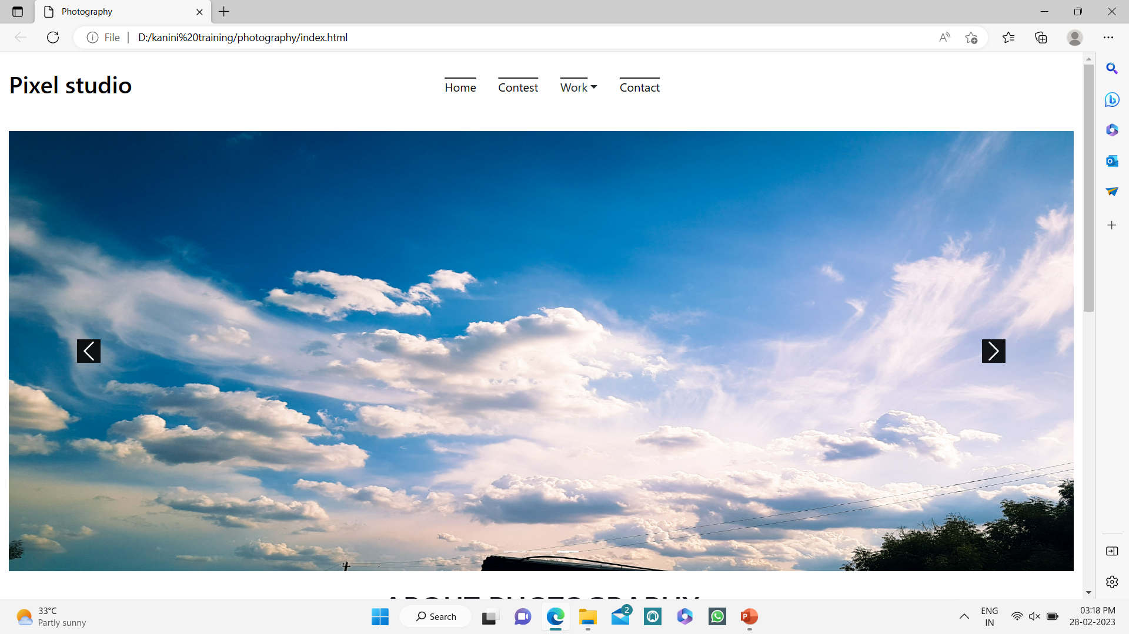
Landing page

Slide 4
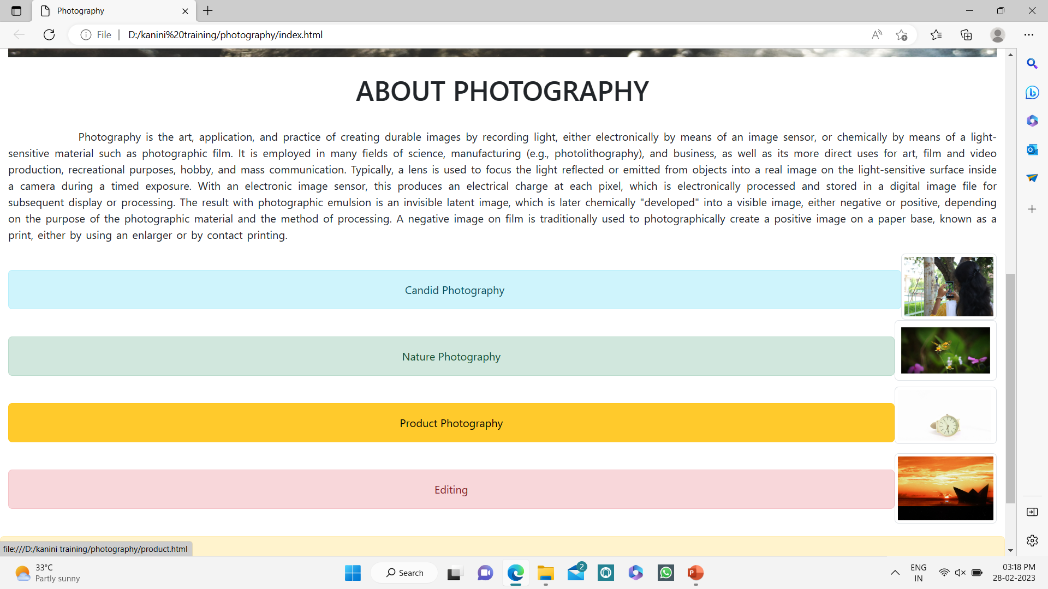

Slide 5
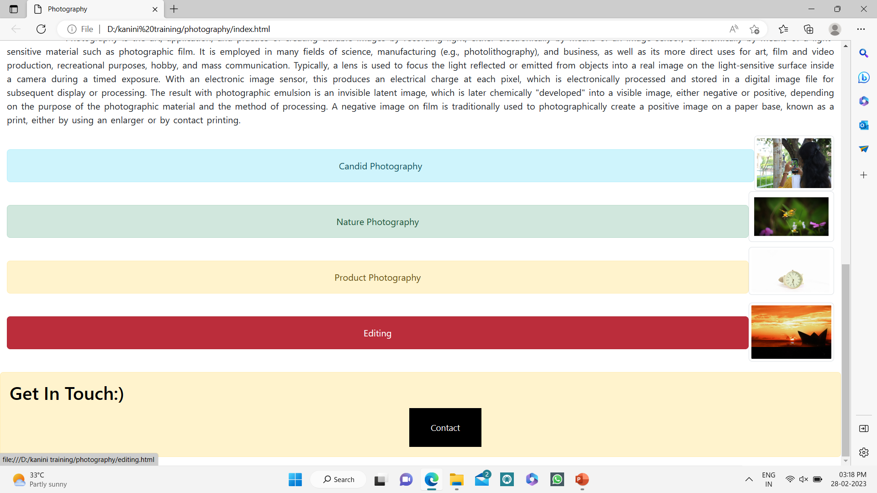

Slide 6
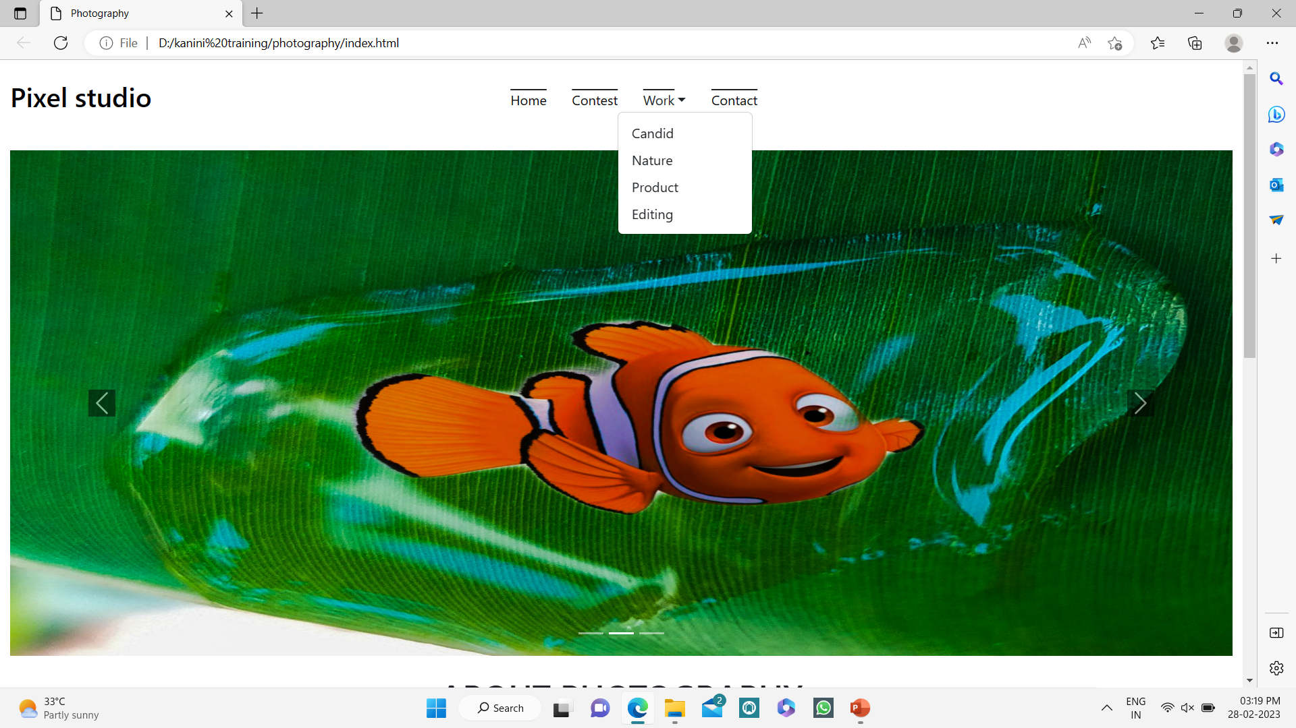

Slide 7
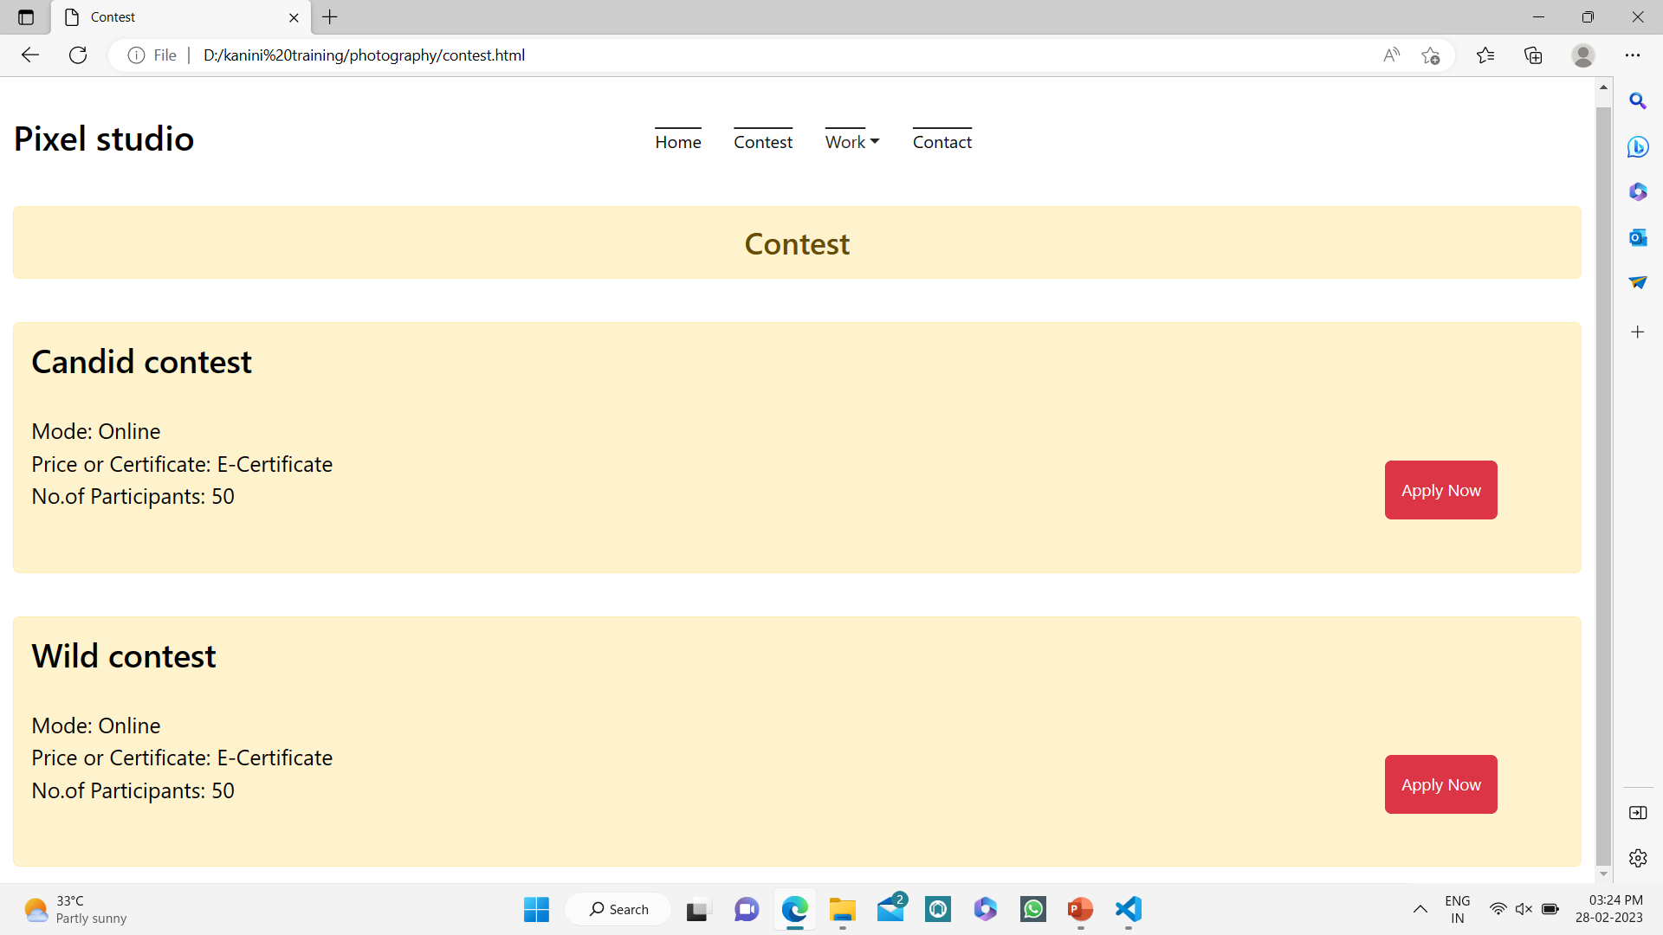
Contest

Slide 8
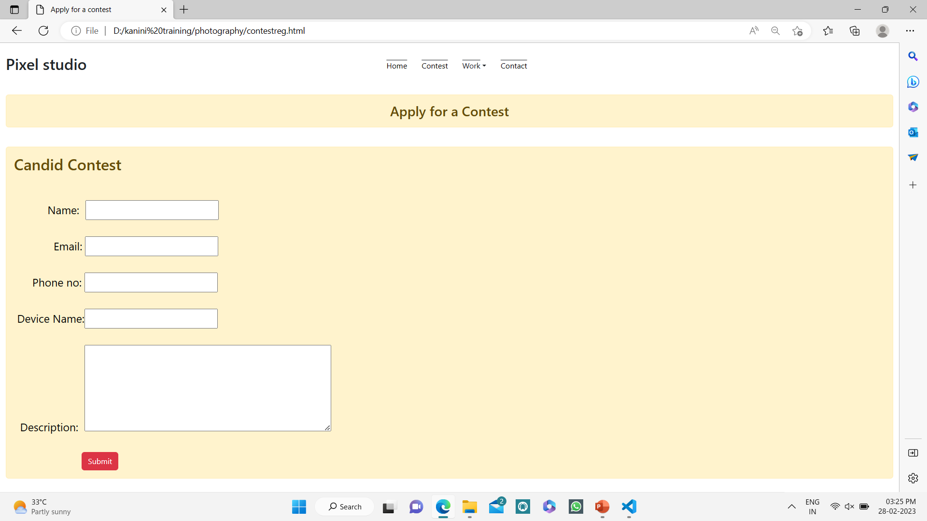

Slide 9
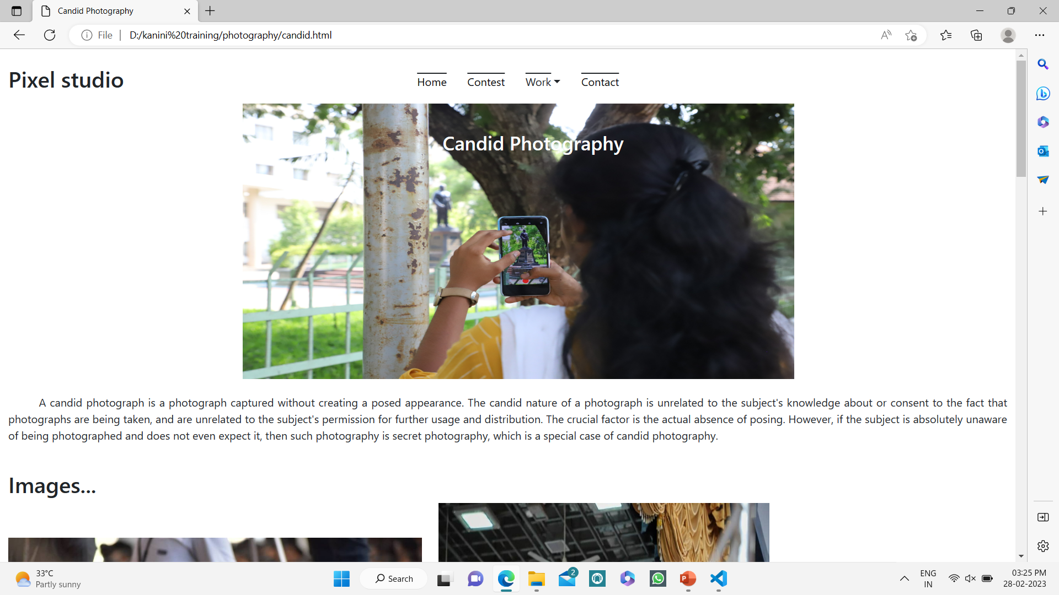
Work

Slide 10
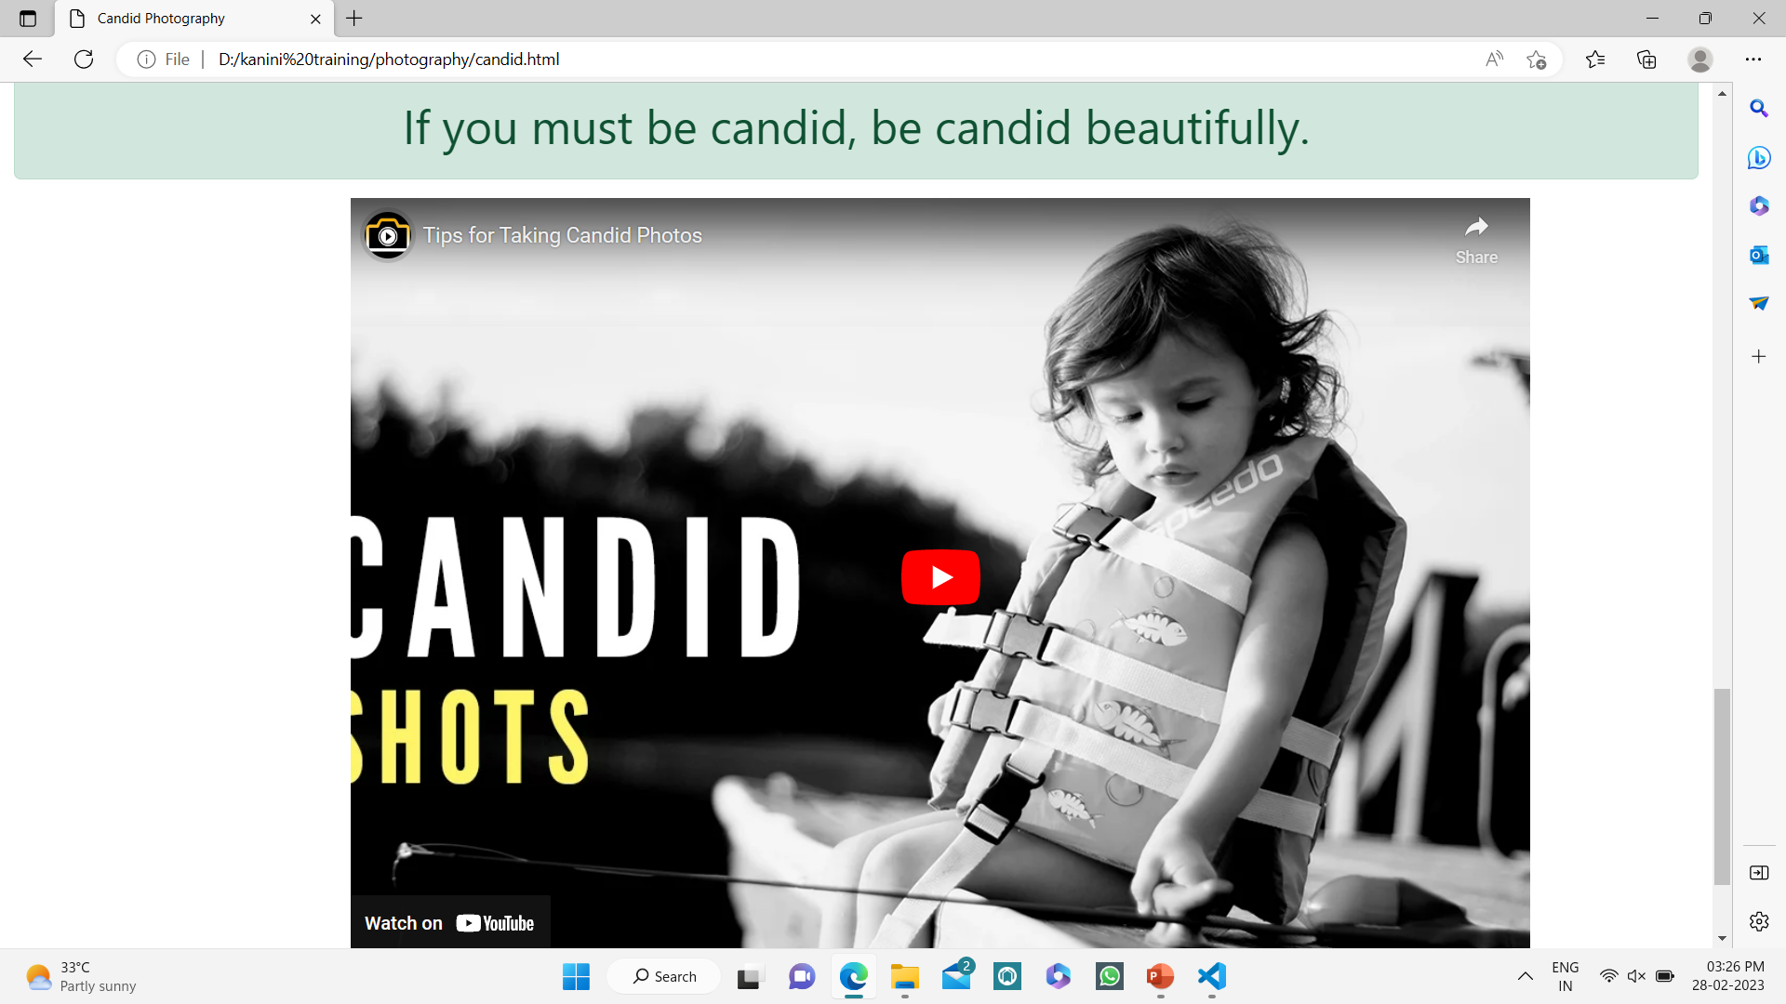

Slide 11
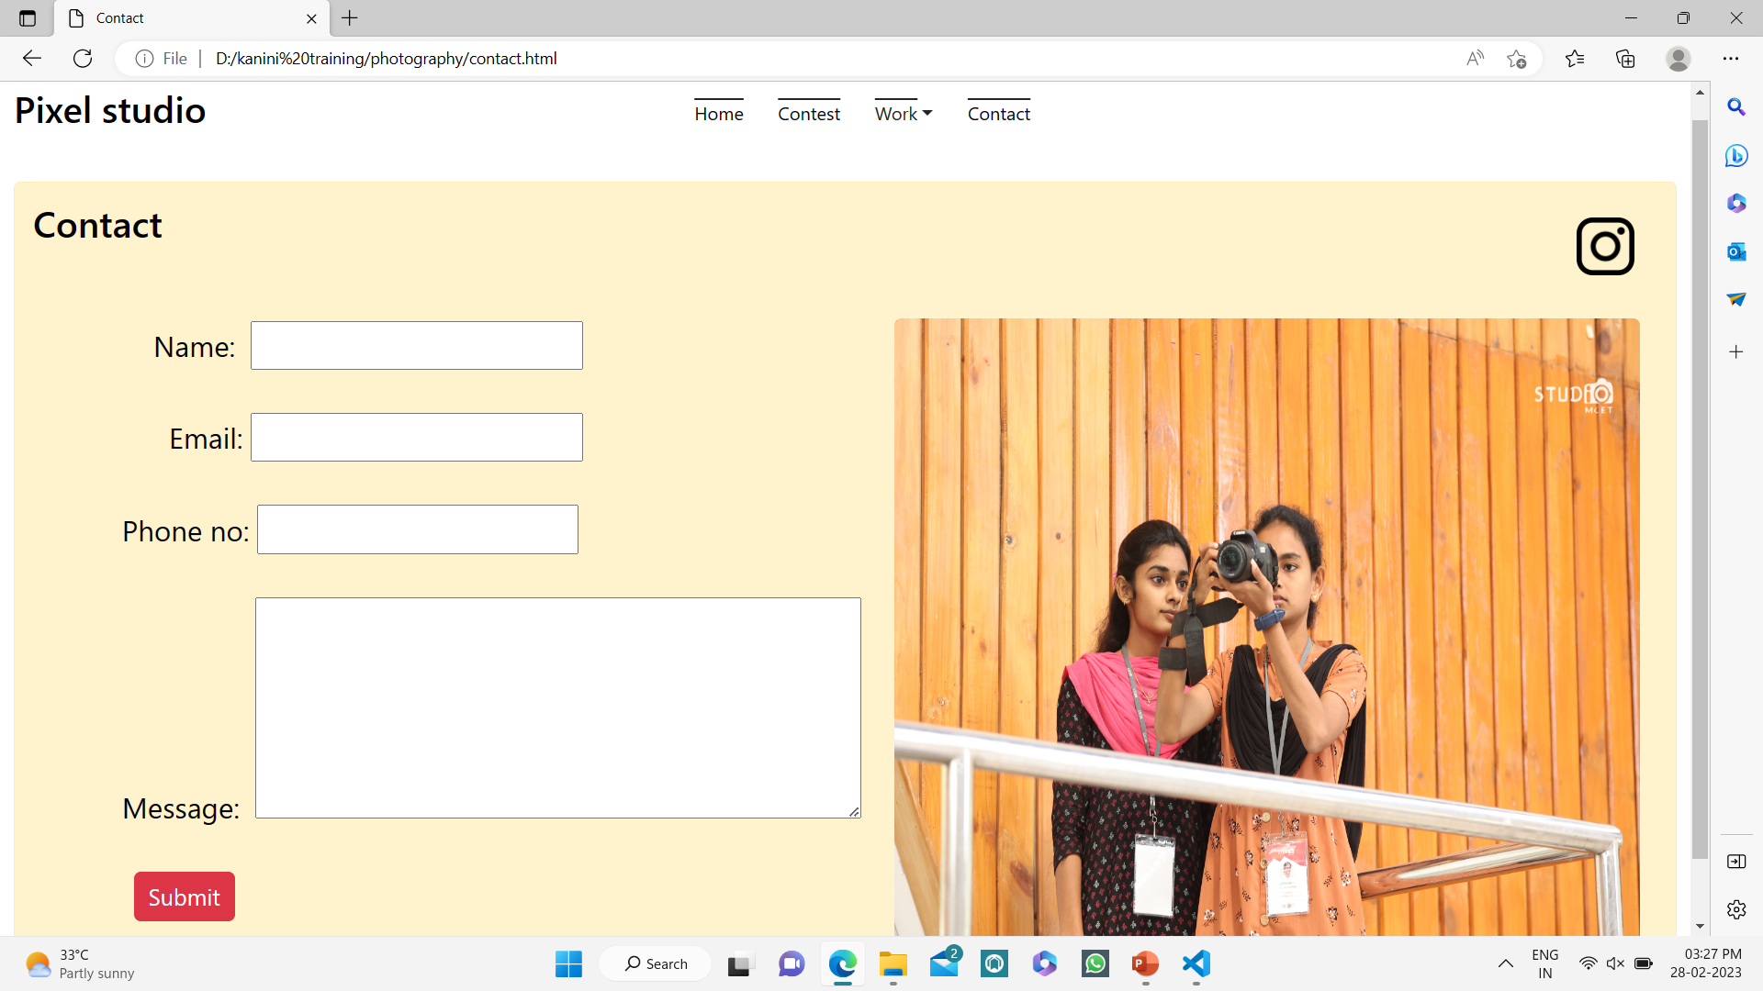
Contact

Slide 12
THANK YOU!

